Slide 1
Restaurant Database
Eric Vela and Charlie Liu

Slide 2
Problem We Intend to Solve
Have had bad/less than stellar experiences at restaurants
Bad service, food, seating arrangements
Not enough parking
Did not accommodate very well
Too expensive
Never know what is on the restaurant’s menu until arrival
Unknown reviews

Slide 3
Our Solution
Create an easy to use user interface comprised of restaurant information
For consumers and businesses
Ability to access information online
Search for restaurants that meet your search criteria
Find reviews and menu on the restaurant beforehand
As a business, posting and updating information can be easily done

Slide 4
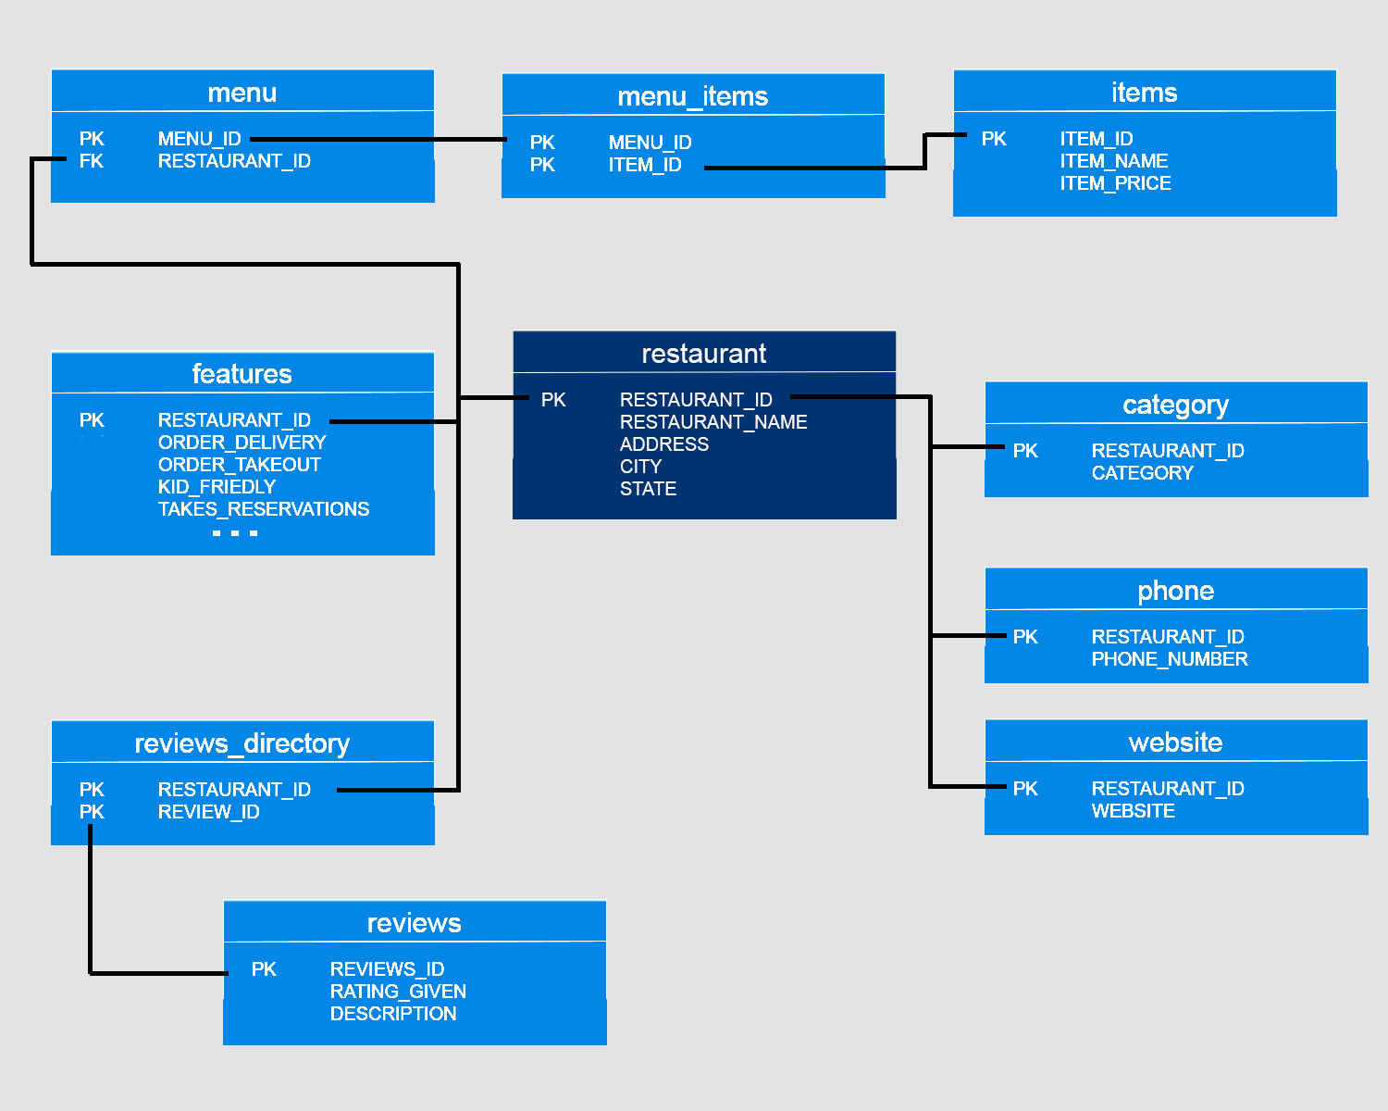
Database Schema

Slide 5
User Interface Demo

